Slide 1

DIG Documentation Refresh
April to December 2019

Slide 2
Introduction
In order for DIG to enable the success of the organization, the team is investing in improving and building processes to maintain documentation. This deck captures the effort prioritized for the Fiscal Year of 2019.
A vendor team of Lou Berner and Janelle Leonard was brought in mid-April By Jennifer Beckmann for a short 12-week project to evaluate and update the Owiki documentation.
This project was extended twice and ended in December 2019 resulting in much improved team documentation.
This deck will outline the goals of the project, the motivation behind it, and the results upon completion.
There is still work to do and our hope is that the team will now be empowered to take on the work of maintaining the documentation internally and that this has increased productivity.

Slide 3
Quote
Regardless of what we discover, we understand and truly believe that everyone did the best job they could, given what they knew at the time, their skills and abilities, the resources available, and the situation at hand.
At the end of a project everyone knows so much more. Naturally we will discover decisions and actions we wish we could do over. This is wisdom to be celebrated, not judgement used to embarrass.
Norm Kerth, Project Retrospectives: A Handbook for Team Review

Slide 4
Quote
By three methods we may learn wisdom:
First, by reflection, which is noblest;
Second, by imitation, which is easiest;
and third by experience, which is the bitterest.
Confucius

Slide 5
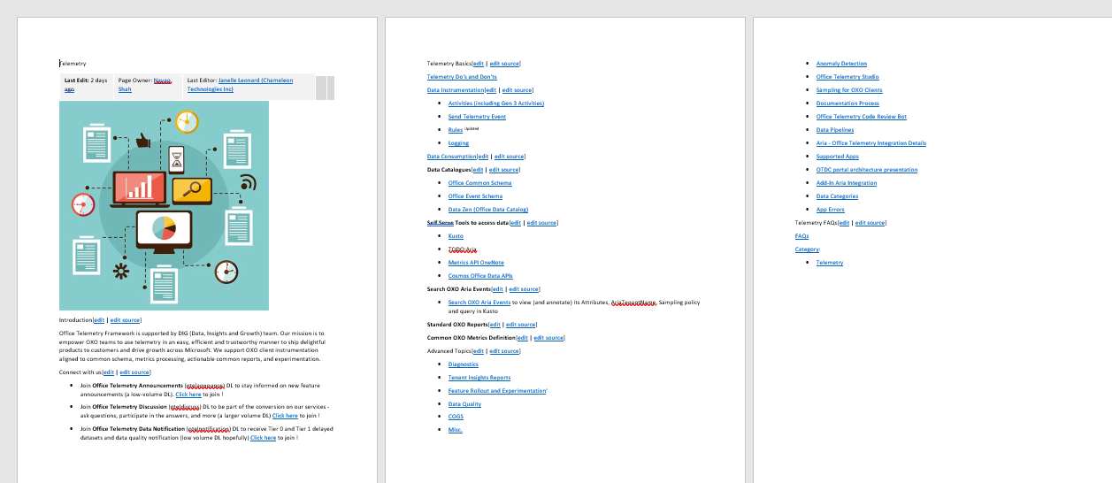
Original Telemetry Page

Slide 6
Where we began
We started with one telemetry splash page on Owiki that was not very functional and difficult to use. Users routinely would ask SME’s questions instead of using this page as the information was outdated and some links did not even work. This was a time consuming and expense proposition and low ROI practice. SME’s were spending too much time away from engineering projects due time lost answering questions.
Vendor team of Lou Berner and Janelle Leonard brought in mid-April By Jennifer Beckmann for a short 12- week project to evaluate and update the Owiki documentation.
The next two slides are opinions from our customers and partners when this project began.

Slide 7
"Ramp up documentations. I still have to go and ask people about very basic things that are not there in OneNote or any wiki and is something that should be documented.“
"There is almost no documentation.”
“Documentation of procedure, design, tools would have helped a lot.“
"Better organized documentation on the wiki. I've noticed there is a ton of information out there, but it's badly organized, formatted and sometimes out-of-date.“
"Better documentation!“
"There wasn't a team onboarding document that listed the tools I will need to install and configure.“
"More available documentation suited for a new hire“
"More documentation on how things work.“
"A place where all onboarding instructions are stored instead of 1057 emails.“
"More structured onboarding documentation for team specific knowledge“
"I think some introduction pages about the culture, technology and growth of the team should help the onboarding process.“
"Documentation and information centralized on one platform“
"I believe having easier access to documentation and information essential to ramp up fast.”
"Better documentation. Lots of new acronyms and tribal knowledge makes the learning curve very steep.“
"Easier to access and find relevant documentation.“
"Better and more consolidated onboarding documentation, both for general new hire issues and for the specific project ramping up.“
"A website or document with all the important concepts, processes and other information summarised in one place.“
"Better documentation. Traversing a large OneNote is pretty hard unless you know exactly what you're looking for. Thankfully this was compensated by having a senior team member as a mentor. I just wish I could rely more on docs.“
"More focused information/documentation on the areas my role is touching."
"More documents and help on where to find stuff or who to ask.“
"The onboarding information was spread across OneNotes and owiki pages. Concatenating all of this information into one place (eg owiki) would make the process a lot smoother.“
"Clearer direction to onboarding documentation, or more available colleagues so that I can ask more questions."
"Documentation or guidelines on how to start working in a particular team. More than 1-day onboarding Laptop from the first day to get the code and inspect the tooling" "Internal systems are very disparate and not very well documented. I still don't know whether I have access to all the necessary locations. Each team should have an up-to-date document with all the necessary steps in a central location that is easily searchable.“
"Better documentation of the onboarding process (how to set up my desktop, what I needed to enlist in, etc.).“
"Better and more updated documentation“
"Better documented development setup, faster building process of Skype“
"Standard documentation about developer workflow tools would have made this better (every sub-team seems to have created their half-backed documentation about this, while the documentation from the developer workflow tools team is totally undiscoverable (or very very stale) other than by chance).“
"Office developer 101 checklist would be helpful, as one we have for oncall.“
"Better documentation would have made it easier to contribute sooner. Pair-programming could also help.“
"Better documentations“
“Better and more updated documentation”
“Documentation and wikis would have been a *lot* helpful”
Our new hires say...

Slide 8
"Finding information is very difficult."
"Engineering documentation."
"many products seem immature, poorly documented"
"System documents need update more frequently"
"The documentation"
"Tools and services doesn't have any helpful documentation, API reference or anything." Documentation and training for new hires. There is a lot to learn through so many of the technologies and tools that are made available to us. I definitely feel that Microsoft has the tools I need to do any part of my job efficiently, but it would be nice to be able to easily find them and understand them quickly/efficiently for usage."
"More documentation on how to use different tools"
"Proper documentation in engineering teams for new hires is required as many people join from different domains with very little understanding of Microsoft domain."
"Tools, specially in Mac Also we need to have better documentation on the available tools"
"Where to find specific information. Best practices and examples documentation. "
"Broad level documentation on different parts of Microsoft tools and codebase "
"Documentation is more or less non-existent on many features. Would like to see some central source for design documents and perhaps user guides."
"Documentation, or perhaps just organization of existing documentation. It's my first month here, and I'm totally lost on how to do basic stuff, and while I have been pointed to some documentation, it's scattered all over the place, and I can't find it on my own. It's scattered between OneNote, Sharepoint, and command help files. Perhaps this is already done, and I just don't know about it, but then that means that the onboarding process needs to be improved."
"Enhance Documentation."
"Internal tools, documentation"
"More coherent documentation"
"Better and up-to-date documentation and support. "
"documents and tutorial"
"Training and documentation around VSTS. A lot of our engineers do not know how to take advantage of the great engineering tools we have"
"Better documentation"
"Design Documents for different modules should be present"
"Documentation, there are tool and code that is only use in Microsoft, there are pieces of documentation scattered around, making them hard to use sometimes."
"Terrible documentation. Non-intuitive and non-standard user experience."
"The onboarding process for some systems can be very complicated and badly documented"
"We should have a tutorial or bootcamping on all tools"
"what's the difference between in-house tool (like sd) and open source tools like git? Documentation!!!! without proper documentation, no one will ever be able to harness the power of that tool"
"As a new hire, the version control system, build, and aux tools in the Office code base are unique to Microsoft and require ramp up using documentation and tribal knowledge before being productive."
"Documentation. People who claim their code is self-documenting are almost all liars."
"Documentation. It's hard to find information on various parts of the system - I'm sure the documentation is there, but I (and my peers) have difficulty knowing where to look."
"More documentations and updated resources should be better."
"More introduction and help docs, more examples"
"What sorely is needed is a centralized source of documentation and best practices for our tools and engineering processes."
"Detailed and upto date documentation of build system. "
"poor documentation and training"
"Documentation for build system: user scenarios like "I want to add a dependency to a new library, what steps are required?"
"Documentation, error logging, stability, and speed."
"Our process documentation especially with developing on non-windows platforms."
"Almost all internal tools throughout the development cycle lacks good documentations, for example: Griffin."
Everyone else says...

Slide 9



Goal of this project
Sustainable, org-wide, quality docs
Keep them in good shape over time
Both central and team-specific
Accurate, understandable, discoverable

Slide 10

Motivation
Documentation & Training was #1 aspect of engineering systems needing improvement Microsoft-wide in CY18.
Engineering Systems Documentation was #1 most negative aspect of joining Office in in CY18H1.
Documentation & Training was #3 aspect of engineering systems needing improvement in E+D in CY19H1.

Slide 11

The Plan to Improve Documentation
Initial Proposal
•Existing docs - Provide pointers to the doc collections we will be working with. We will need read/write permissions for them.
•New host sites - Discuss/Identify where new production collections will be hosted. May be the same as current, may be different. Grant permissions for new sites, as necessary.
•Audience - How are these docs being used? Common use cases, how users find topics, what problems they are solving, plus escalation paths.
•Search - How important is it? What search metadata are in place already? What needs to be improved?
•Revision history - How important is it to make revision tables visible to users?
•Content governance - Identify stakeholders and SME resources for content reviews, sign-off, and content governance.
•Reporting - How do you want to be informed? Who wants to know what, and how often? Identify the most important KPI, how to measure success.
•Priorities - Identify the top 3-5 collections or nodes for the Q4 time frame, ideal results, and how to manage up to deliver results with great visibility.

Slide 12
Original Topics Backlog
Experimentation | Adding metrics and metric sets to scorecards | High
Experimentation | ITAR setup | Low
Experimentation | How long should a test run? PowerCalculation using existing xCards, and calculating it manually | Medium
Experimentation | Onboarding and SDKs | Medium
Index | Diagnostics and Reliefs | High
Index | In App Feedback | High
Index | Feedback and Floodgate SDKs (Android, iOS, Web)Floodgate SDK (macOS, Win32) | High
Index | Octane pipeline | Medium
Index | Petrol API | Medium
Metrics | Office Event Schema | High
Metrics | Metadata Documentation | High
Metrics | How to work with Consent | High
Metrics | Key Telemetry Events | High
Metrics | How to use Anomaly Detection | High
Metrics | LinchPin documentation | High
Metrics | How we sample | Medium
Metrics | OTelJS SDK | Medium
Metrics | DataSets & Views | Medium
Metrics | Utility Functions | Medium
List of tasks that were planned at the beginning of the project

Slide 13
Original Topics Backlog
OCV | No new content. Move entire documentation of 50 pages from SharePoint to owiki.ms and deprecate old wiki. | High
Telemetry | Office Telemetry Studio | High
Telemetry | Activities | High
Telemetry | Send Telemetry Event | High
Telemetry | Using Kusto Second one was added by someone from WAC https://www.owiki.ms/wiki/Telemetry/Data_Consumption/Aria/Kusto https://www.owiki.ms/wiki/Telemetry/Data_Consumption/Consuming_Data/Kusto | High
Telemetry | Diagnostics | High
Telemetry | Rules | High
Telemetry | Logging | High
List of tasks that were planned at the beginning of the project

Slide 14
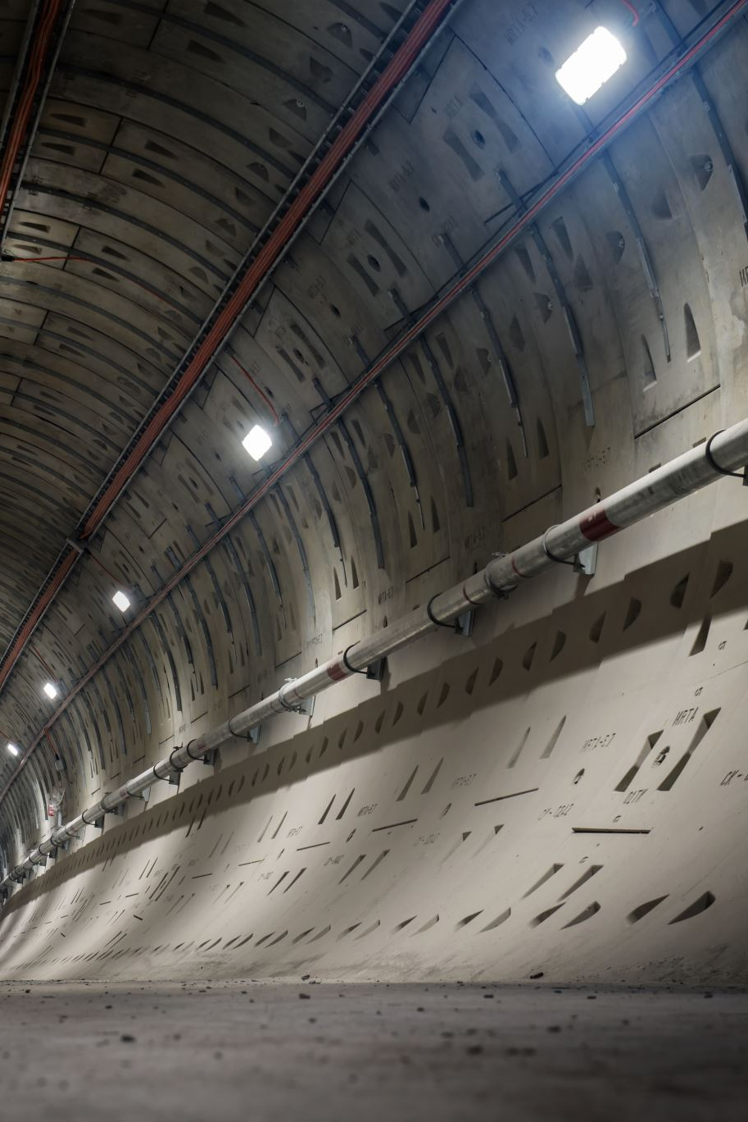
Site Architecture
Originally one page that was very simple and hard to use, ended with one central page that includes many areas of focus and each team has their own homepage.
The Telemetry splash page has a four-pronged self-service approach that a user is instructed to use before contacting a SME ( to reduce time spent answering questions by SME’s can point users to this page):
Documentation: Owiki
Tools: specific to each area of focus
Engage: Stackoverflow ,Teams, email DL
Escalation Paths: ICM, Fork Blocking Bug
Future actions will eliminate the two previous versions of this page on Owiki as feedback indicated that these pages were too team specific for a broader audience:
https://www.owiki.ms/wiki/DIGTeam/DIG_Partner_Resources
https://www.owiki.ms/wiki/Telemetry/Getting_Started

Slide 15
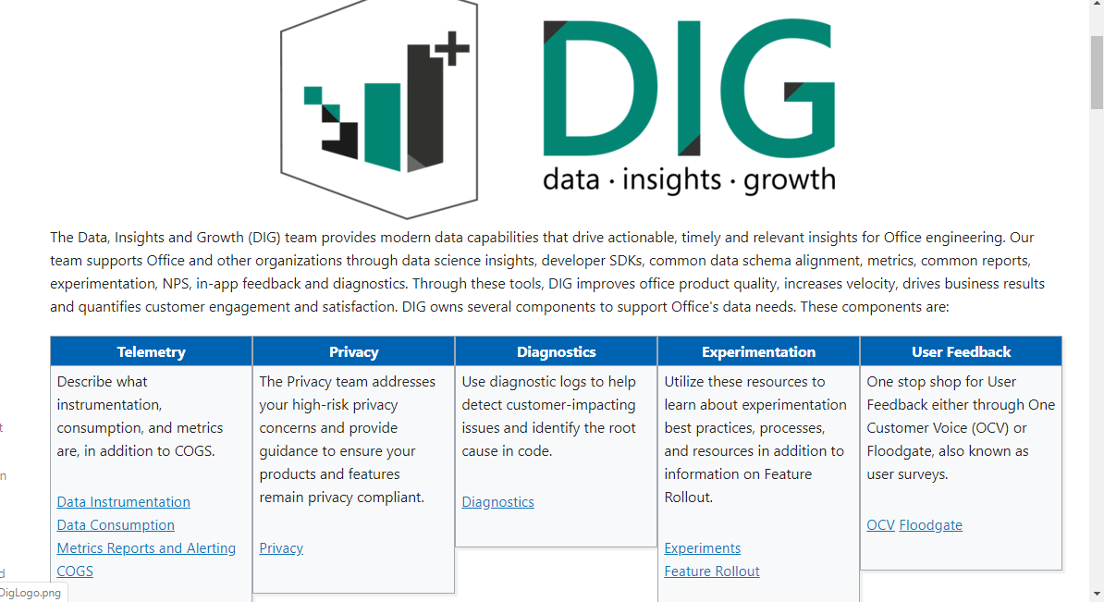
New Telemetry Splash Page
https://www.owiki.ms/wiki/Telemetry

Slide 16
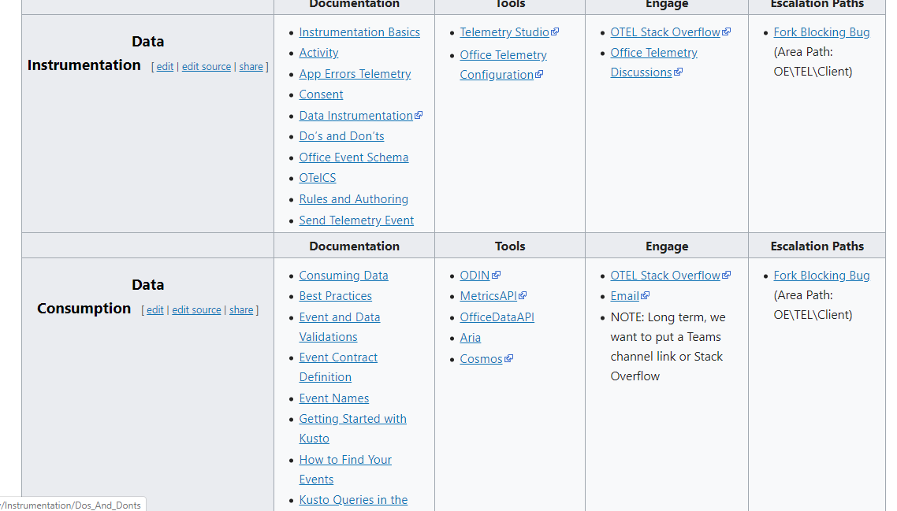
Telemetry Splash Page Table https://www.owiki.ms/wiki/Telemetry

Slide 17
10 New Homepages
10 homepages that are now linked from the Telemetry splash page
Consuming Data
Diagnostics Homepage
Metrics and Alerting Guide
Experimentation Homepage
COGS Homepage
Feature Rollout Homepage
OCV Homepage
Floodgate Homepage
Instrumentation Basics
Privacy Homepage

Slide 18

Owiki Page Improvements
DIG Content Scrub
Beginning
500+ pages with content spread out over SharePoint, Word docs and OneNote collections
Ending
375 Owiki pages
100 pages migrated from OneNote to Owiki (Privacy)
50+ pages migrated from SharePoint to Owiki (OCV)
Page views and Usage increased substantially
Original owiki page views:
Current page views can be viewed in Page Information on each page:
(Example:Page view information for Telemetry splash page)

Slide 19

Owiki Page Improvements.. Continued
Categorization
Each page was assigned to specific owiki categories to enable pages to be tracked. The following basic categories are on every DIG Owiki page and can now be tracked by these categories.
Category:Telemetry
Category:FUEL
Category:DIG
Category:DIG Team
Page ownership
Each page was assigned to the relevant Distribution Group based on Team.
For example: OfficeEventSchema belongs within the Data Instrumentation topic/team so its DG owner is Otelcet@microsoft.com. This allows users to email this DG if there are questions about the page (as a back up in case they do not see the Engage section for this team).

Slide 20
11 Net New Owiki Topics
Office Event Schema
Metrics and Scorecards
Consent
Diagnostics
Sampling
Floodgate Homepage
Feature Rollout
Mod GA and Dogfood
Office Telemetry Studio
Activities
Rules and Authoring
16 of 30 original topics completed from original backlog

Slide 21
How to Documents and Templates
To be used by team once project completes
How to Create a New Owiki Page
Privacy template
Custom Horizontal Table Office Orange
Custom Sidebar Table Office Orange
Creating_Owiki_Content

Slide 22

What Worked, What Were the Challenges
Below are some questions for your team(s) to consider to help you in future endeavors and to help as you take on the work of maintaining the documentation internally:
Are you pleased with of our finished work? If yes, what made it great?
Did we get the results you intended, and did it make an impact?
What was the biggest impediment?
Which of our methods or processes were difficult or frustrating to use?
What was painful but necessary?
What did we leave unresolved? How can the team take these and drive them to completion?
What should be done in the future to maintain the documentation?
How will we pivot from here?

Slide 23
Coming Up 2020
Left blank for the team to discuss what still needs to be done.

Slide 24

Summary and Contact Information
In conclusion, the efforts of the past 9 months has increased user page views, documentation is consistent and easy to use. The hope is that SME’s have gained back increased engineering time due to decreased user questions and a solid resource to send users to for assistance. There is still work to be done and the team has plans to assist with maintaining this documentation internally.
Janelle Leonard and Lou Berner contact information :
email:
janelle553@gmail.com
bernerenterprisesllc@gmail.com
Linkedin:
linkedin.com/in/leonardjanelle
linkedin.com/in/louis-berner

